Slide 1
Histogram Equalization

Slide 2
What is Histogram Equalization?
Histogram equalization is an approach to enhance a given image
The approach is to design a transformation T(.) such that
The grey values in the output image are uniformly distributed in image value range

Slide 3
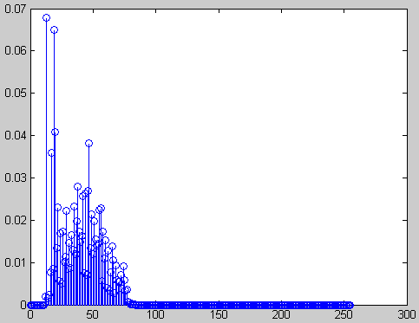
Example
Original image and its histogram

Slide 4
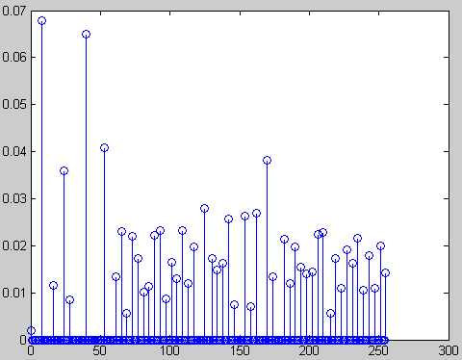
Example
Histogram equalized image and its histogram

Slide 5
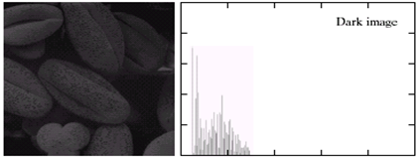
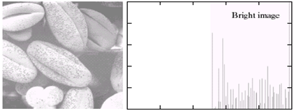
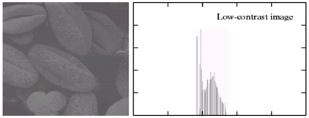
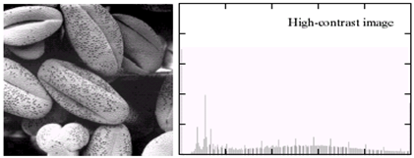
Better Example

